Slide 1
Predicting Loan Outcomes
Name: krishna chaitanya ch
Batch no: PGDDM44
Machine Learning PROJECT

Slide 2
Machine Learning
Machine learning teaches computers to learn from data, not specific instructions.
It’s like how humans learn by example and practice.
Computers improve by recognizing patterns in data.
The more data they see, the better they become at making predictions or decisions.

Slide 3
Algorithms
Random Forest Classifier
Logistic Regression
Decision Tree Classifier
Support Vector Classifier (SVC)
K-Nearest Neighbors (KNN)
Gaussian Naive Bayes (GaussianNB)

Slide 4
Random Forest Classifier:
Type: Supervised, Classification (ensemble method)
Combines multiple decision trees to improve accuracy and control overfitting.
Each tree makes a prediction, and the majority vote determines the final result.
Logistic Regression:
Type: Supervised, Classification
Logistic Regression is a Machine Learning algorithm which is used for the classification problems.
It is a predictive analysis algorithm and based on the concept of probability.

Slide 5
Decision Tree Classifier:
Type: Supervised, Classification
A tree-like model of decisions.
Each node splits the data based on a feature to maximize the information gain, and leaves represent class labels.
Support Vector Classifier (SVC):
Type: Supervised, Classification
Finds the hyperplane that best separates data into classes. It aims to maximize the margin between different classes.
Can be used with different kernels for nonlinear classification.

Slide 6
K-Nearest Neighbors (KNN):
Type: Supervised, Classification (also used in regression)
Classifies a data point based on the majority class of its nearest neighbors. It is a simple, non-parametric method but can be computationally expensive for large datasets.
Gaussian Naive Bayes (GaussianNB):
Type: Supervised, Classification
Assumes features follow a Gaussian (normal) distribution.
Based on Bayes' Theorem and works well for independent features, often used for text classification.
Formula=P(A/B)=P(B/A)P(A)/P(B)

Slide 7
Dataset Overview
Dataset Name: Bank Data
Number of Rows: 803
Number of Columns: 11

Slide 8
Column Data Overview
Bank Dataset:
Customer Id , Customer Name,
Credit Score , Location ,
Gender , Age , Balance ,
Loan Taken , Loan cleared ,
Estimated Salary , Exited .

Slide 9
Accuracy:
The proportion of total correct predictions (both positives and negatives) made by the model.
Formula: Accuracy=TP+TN/TP+FP+FN+TN
Classification Report:
The classification report provides key evaluation metrics (precision, recall, F1 score, and support) for each class in a classification task.
It's typically used to assess the performance of a classification model.

Slide 10
Key Metrics in the Classification Report:
Precision: The proportion of correctly predicted positive instances for each class.
Recall: The proportion of actual positives that were correctly identified by the model.
F1-score: The harmonic mean of precision and recall, used to balance both metrics.
Support: The number of true instances for each class.

Slide 11
Confusion Matrix:
A confusion matrix is a table that describes the performance of a classification model by comparing predicted and actual class labels. It allows us to see not only the errors made by the classifier but also the types of errors.
Interpreting the Confusion Matrix:
True Positives (TP): Correct predictions for each class.
False Positives (FP): Instances incorrectly predicted as a given class.
False Negatives (FN): Instances that belong to a class but are predicted as a different class.
True Negatives (TN): Correct predictions for other classes not being considered.

Slide 12
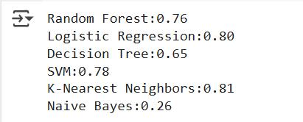
Accuracy

Slide 13
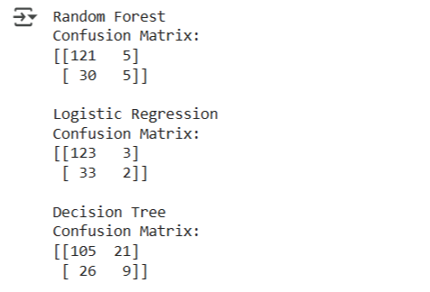
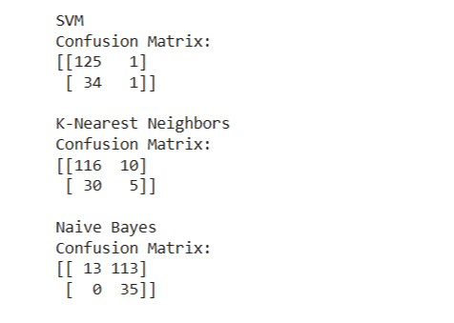
Classification report

Slide 14
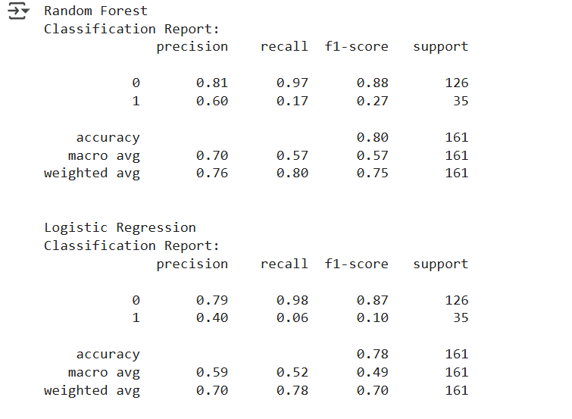
Confusion matrix

Slide 15
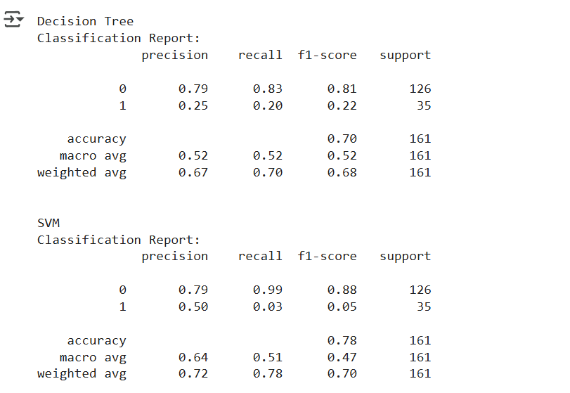

Slide 16
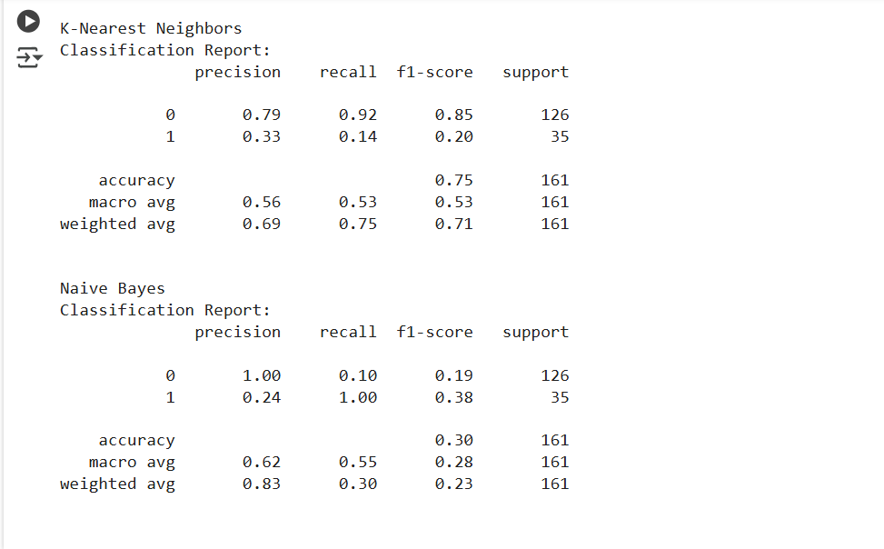

Slide 17
Conclusion
Continuous Learning
Real-world Applications
Scalability
Efficiency
Ethical Considerations

Slide 18
THANK YOU

